Slide 1

Bank Of Apis
Presented By
Ritu Kumari Lohar
Superset ID : 4828490

Slide 2
Problem Statement
Managing multiple bank accounts and transfers is complex for customers.
Customers need a single platform to:
View account balances and transactions
Transfer money securely
Traditional systems lack centralized, user-friendly solutions

Slide 3
Objectives
Provide a secure login & authentication system.
Allow users to view account details & statements.
Enable fund transfer between accounts.
Ensure responsive design (desktop + mobile).
Build a scalable backend with REST APIs.

Slide 4
Technology Stack
Frontend: Angular (with Angular Material for UI)
Backend: Java, Spring Boot (REST APIs)
Database: MySQL
Tools: Postman (API Testing), GitHub (Version Control)

Slide 5
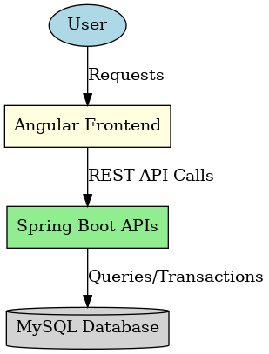
System Architecture
[ Login / Registration ]
[ Dashboard (Overview of Accounts) ]
[ Account Page / Fund Transfer ] { Functionalities / Back } [ Dashboard (Overview of Accounts) ]
[ Logout ]

Slide 6
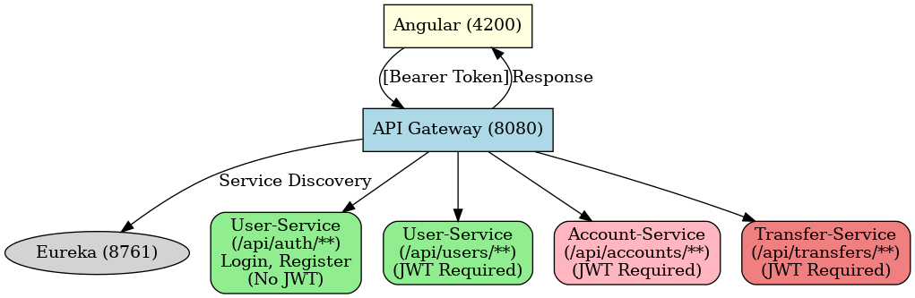
System Architecture
Angular (4200)
↓ [Bearer Token]
API Gateway (8080) →Eureka (8761)
│ │
│ |--> /api/auth/** → user-service (login, register, no JWT needed)
│ |--> /api/users/** → user-service (JWT required)
│ |--> /api/accounts/** → account-service (JWT required)
│ |--> /api/transfers/** → transfer-service (JWT required)
↓
Response to Angular

Slide 7
Implemented Features
✅ User Registration & Login (with password encryption)
✅ Dashboard with account overview
✅ View linked bank accounts & balances
✅ Fund Transfer (with confirmation & status)

Slide 8
Future Scope
Add Credit Card Management (transactions, bill payment)
Add Admin Panel (user monitoring, API logs)
Integrate Notifications (email/SMS)
Add Cloud Deployment for scalability

Slide 9
Demo Plan
Register/Login
Dashboard view
View accounts & transactions
Fund transfer demo

Slide 10
Conclusion
Learned Java Full Stack Development (Angular + Spring Boot + MySQL)
Implemented secure, responsive, and scalable banking APIs
Gained hands-on practice in API design
Thankyou

